Slide 1
Coordinate Systems and Self Leveling
Lecture 011 – 02
RBE500 F16
Adj. Prof. J. Center

Slide 2
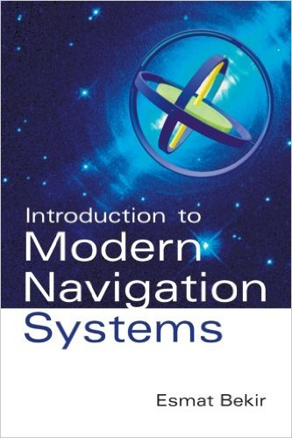
Reference Reference
Esmat Bekir, Introduction to Modern Navigtion Systems,
World Scientific, 2007

Slide 3
Representing a vector in a Coordinate system

Slide 4
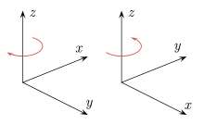
Left-Hand and Right-Hand Coordinates
Left-Handed Coordinates
Right-Handed Coordinates

Slide 5
Left-Hand and Right-Hand Coordinates
We will use Right-Handed Coordinates

Slide 6
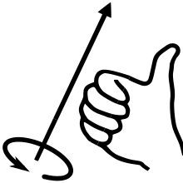
Right-Handed Convention for Rotation

Slide 7
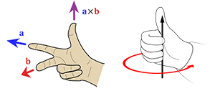
Right-Handed Rules
Z
X
Y

Slide 8
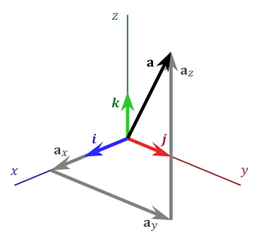

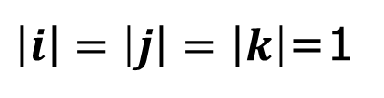

Vector Representation in a Coordinate Frame
Unit Vectors along Coordinate Axes
$$i, j, k$$
$\left|i\right|=\left|j\right|=\left|k\right|$=1
Representation of Vector a
in unit vectors
$$a=a_{x}i+a_{y}j+a_{z}k$$

Slide 9


Vector Representation in a Coordinate Frame
Unit Vectors along Coordinate Axes
$$i, j, k$$
$\left|i\right|=\left|j\right|=\left|k\right|$=1
Representation of Vector a
in unit vectors
$$α$$
$$a=a_{x}i+a_{y}j+a_{z}k$$
$$a_{x}=a∗i=\left|a\right|cos\left(α\right)$$

Slide 10


Vector Representation in a Coordinate Frame
Unit Vectors along Coordinate Axes
$$i, j, k$$
$\left|i\right|=\left|j\right|=\left|k\right|$=1
Representation of Vector a
in unit vectors
$$α$$
$$β$$
$$a=a_{x}i+a_{y}j+a_{z}k$$
$$a_{x}=a∗i=\left|a\right|cos\left(α\right)$$
$$a_{y}=a∗j=\left|a\right|cos\left(β\right)$$

Slide 11


Vector Representation in a Coordinate Frame
Unit Vectors along Coordinate Axes
$$γ$$
$$i, j, k$$
$\left|i\right|=\left|j\right|=\left|k\right|$=1
Representation of Vector a
in unit vectors
$$α$$
$$β$$
$$a=a_{x}i+a_{y}j+a_{z}k$$
$$a_{x}=a∗i=\left|a\right|cos\left(α\right)$$
$$a_{y}=a∗j=\left|a\right|cos\left(β\right)$$
$$a_{z}=a∗k=\left|a\right|cos\left(γ\right)$$

Slide 12






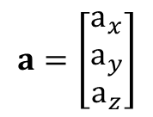
Vector Representation in a Coordinate Frame
Unit Vectors along Coordinate Axes
$$γ$$
$$i, j, k$$
$\left|i\right|=\left|j\right|=\left|k\right|$=1
Representation of Vector a
in unit vectors
$$α$$
$$β$$
$$a=a_{x}i+a_{y}j+a_{z}k$$
$$a_{x}=a∗i=\left|a\right|cos\left(α\right)$$
$$a_{y}=a∗j=\left|a\right|cos\left(β\right)$$
$$a_{z}=a∗k=\left|a\right|cos\left(γ\right)$$
Column Vector Representation
$$a=\left[\begin{matrix}a_{x} \\ a_{y} \\ a_{z}\end{matrix}\right]$$

Slide 13
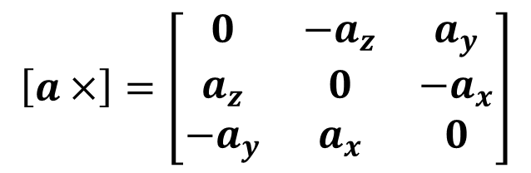
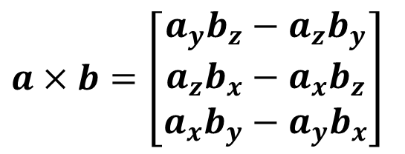
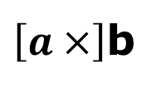
Representing a Vector Cross Product to a Matrix Operation
$a×b=\left[\begin{matrix}a_{y}b_{z}−a_{z}b_{y} \\ a_{z}b_{x}−a_{x}b_{z} \\ a_{x}b_{y}−a_{y}b_{x}\end{matrix}\right]$
Define
$$\left[a×\right]=\left[\begin{matrix}0 & −a_{z} & a_{y} \\ a_{z} & 0 & −a_{x} \\ −a_{y} & a_{x} & 0\end{matrix}\right]$$
Then we can express the vector cross product in matrix form as:
$\left[a×\right]$b

Slide 14
Aerospace Euler Angles representing a coordinate transformation

Slide 15
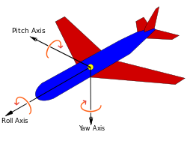
Rotation Conventions

Slide 16
Airplane Coordinates
Y – Right Wing
X - Nose
Z – Down

Slide 17
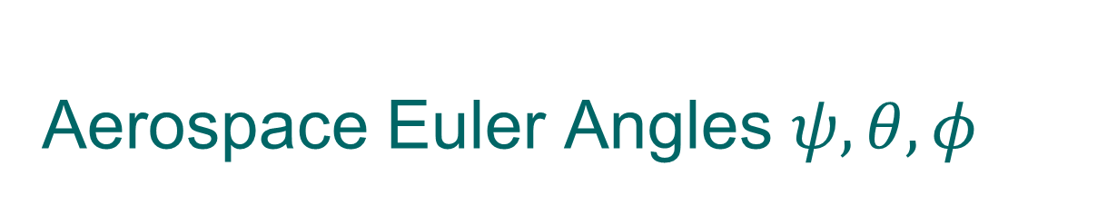

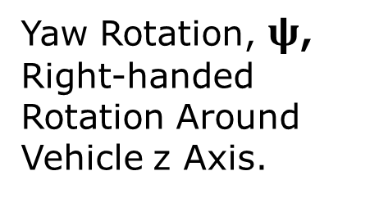
Aerospace Euler Angles $ψ, θ, φ$
Yaw Rotation, $ψ$, Right-handed Rotation Around Vehicle z Axis.
y
E
x
$$ψ$$
N
D, z

Slide 18

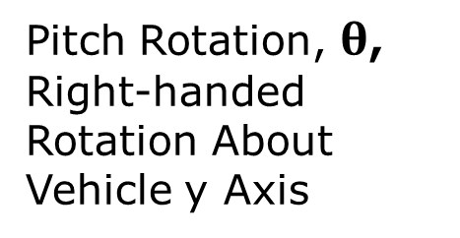
Aerospace Euler Angles $ψ, θ, φ$
Pitch Rotation, $θ$, Right-handed Rotation About Vehicle y Axis
y
E
x
$$θ$$
$$ψ$$
N
z
D

Slide 19

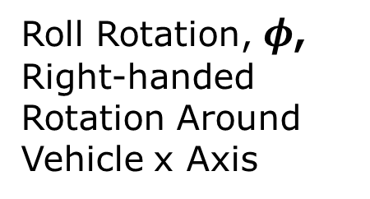
Aerospace Euler Angles $ψ, θ, φ$
Roll Rotation, $φ$, Right-handed Rotation Around Vehicle x Axis
$$φ$$
y
E
x
$$θ$$
$$ψ$$
N
z
D

Slide 20
Direction Cosine Matrix (DCM)

Slide 21
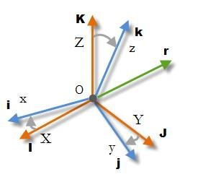
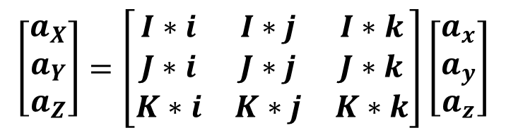

Direction Cosine Matrix
$$\left[\begin{matrix}a_{X} \\ a_{Y} \\ a_{Z}\end{matrix}\right]=\left[\begin{matrix}I∗i & I∗j & I∗k \\ J∗i & J∗j & J∗k \\ K∗i & K∗j & K∗k\end{matrix}\right]\left[\begin{matrix}a_{x} \\ a_{y} \\ a_{z}\end{matrix}\right]$$
Let i, j, k represent unit vectors of the body frame, and let I, J, K represent unit vectors of the navigation frame. Then we represent the equation above by the notation:
$$a^{n}={C_{b}}^{n}a^{b}$$
Relations among unit vectors.

Slide 22
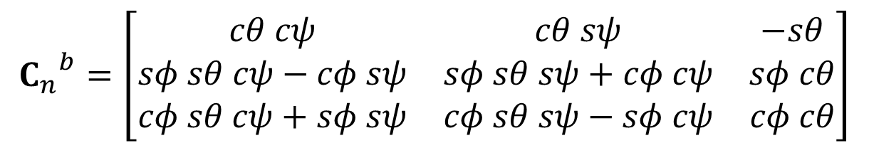
Expressing a DCM in Terms of Euler Angles
We can convert an Euler angle representation of a rotation into the Direction Cosine Matrix that represents the rotation from Navigation frame to Body frame by
$${C_{n}}^{b}=\left[\begin{matrix}cθ cψ & cθ sψ & −sθ \\ sφ sθ cψ−cφ sψ & sφ sθ sψ+cφ cψ & sφ cθ \\ cφ sθ cψ+sφ sψ & cφ sθ sψ−sφ cψ & cφ cθ\end{matrix}\right]$$
Here c represents cosine and s represents sine.

Slide 23
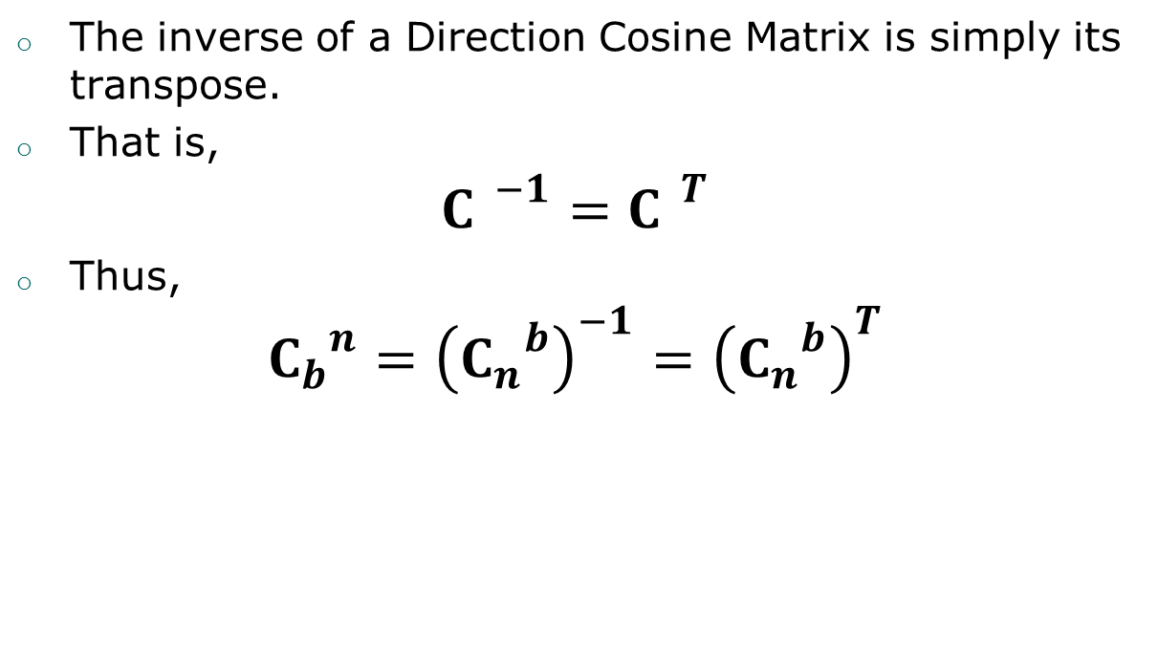
Inverse of a DCM
The inverse of a Direction Cosine Matrix is simply its transpose.
That is,
$${C }^{−1}={C }^{T}$$
Thus,
$${C_{b}}^{n}={\left({C_{n}}^{b}\right)}^{−1}={\left({C_{n}}^{b}\right)}^{T}$$

Slide 24
Rotation Vector

Slide 25
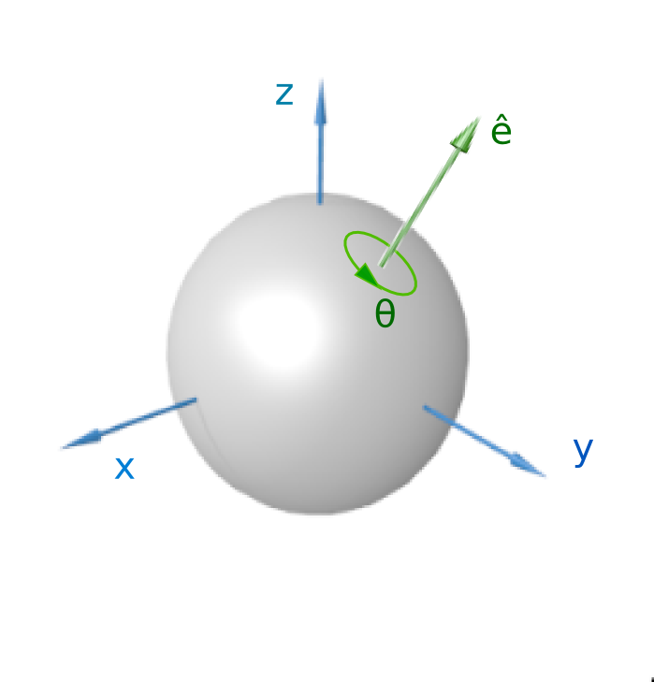
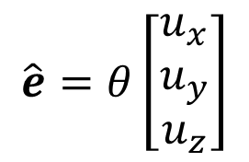

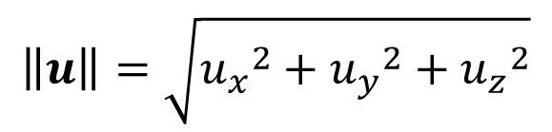
Rotation Vector of Coordinate Transformation
Any Rotation Can be Represented By A Rotation Vector
$$\hat{e}=θ\left[\begin{matrix}u_{x} \\ u_{y} \\ u_{z}\end{matrix}\right]$$
With u a unit vector, i.e.
$$\left\|u\right\|=\sqrt{{u_{x}}^{2}+{u_{y}}^{2}+{u_{z}}^{2}}$$
The Length of the Vector $\left\|\hat{e}\right\|=θ$ Represents the Amount of Right-Handed Rotation About the Unit Vector.

Slide 26
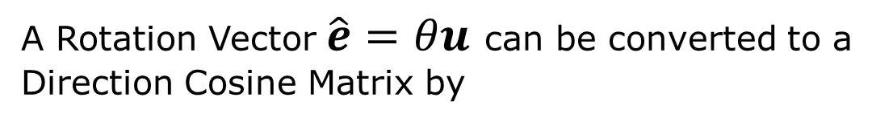
Relating a Rotation Vector to a DCM
A Rotation Vector $\hat{e}=θu$ can be converted to a Direction Cosine Matrix by
$$C=\cos{θ}I+\left(1−\cos{θ}\right)uu^{T}−sinθ\left[u×\right]$$

Slide 27
Quaternions

Slide 28





Quaternion Definition
We can define a quaternion in a form similar to complex numbers as
$$q=q_{0}+q_{1}i+q_{2}j+q_{3}k$$
with the conventions
$$i^{2}=j^{2}=k^{2}=ijk=−1$$
This leads to the relations
$$ij=−ji=k$$
$$jk=−kj=i$$
$$ki=−ik=j$$

Slide 29
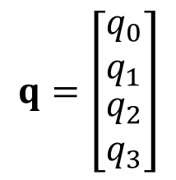
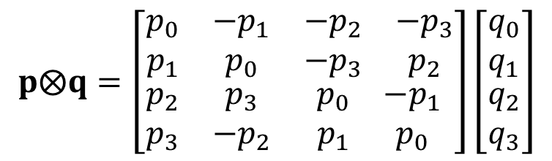

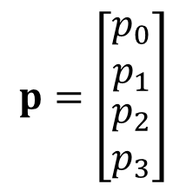
Quaternion Multiplication
We can also represent quaternions as four dimensional column vectors. For the two quaternions p and q as
$$p=\left[\begin{matrix}\begin{matrix}p_{0} \\ p_{1}\end{matrix} \\ \begin{matrix}p_{2} \\ p_{3}\end{matrix}\end{matrix}\right]$$
$$q=\left[\begin{matrix}\begin{matrix}q_{0} \\ q_{1}\end{matrix} \\ \begin{matrix}q_{2} \\ q_{3}\end{matrix}\end{matrix}\right]$$
Using the complex number representation, we can determine that we can represent the product of p and q as
$$p⨂q=\left[\begin{matrix}\begin{matrix}p_{0} & −p_{1} \\ p_{1} & p_{0}\end{matrix} & \begin{matrix}{−p}_{2} & −p_{3} \\ −p_{3} & p_{2}\end{matrix} \\ \begin{matrix}p_{2} & p_{3} \\ p_{3} & −p_{2}\end{matrix} & \begin{matrix}p_{0} & {−p}_{1} \\ p_{1} & p_{0}\end{matrix}\end{matrix}\right]\left[\begin{matrix}\begin{matrix}q_{0} \\ q_{1}\end{matrix} \\ \begin{matrix}q_{2} \\ q_{3}\end{matrix}\end{matrix}\right]$$
$$Note that p⨂q≠q⨂p$$

Slide 30

Quaternion Dot Product
We define the dot product of two quaternions p and q in terms of the dot product of their four-vector representations.
$$p⋅q=p_{0}q_{0}+p_{1}q_{1}+p_{2}q_{2}+p_{3}q_{3}$$
Thus, the norm of a quaternion is defined as
$$\left\|p\right\|=\sqrt{p⋅p}$$

Slide 31
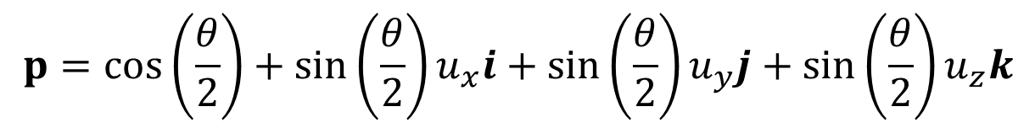
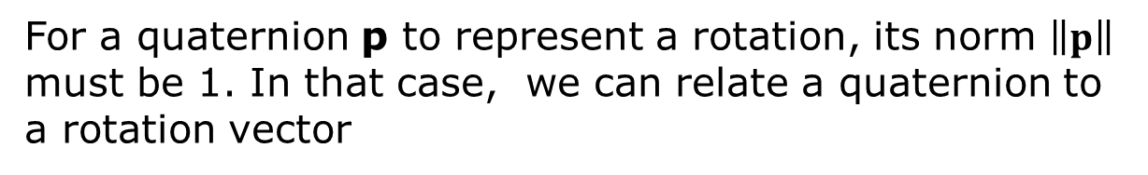
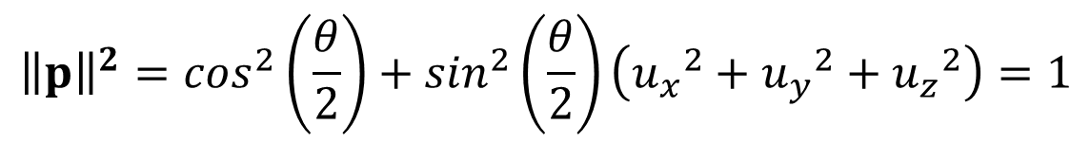
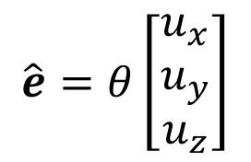
Representing a Rotation as a Quaternion
For a quaternion p to represent a rotation, its norm $\left\|p\right\|$ must be 1. In that case, we can relate a quaternion to a rotation vector
$$\hat{e}=θ\left[\begin{matrix}u_{x} \\ u_{y} \\ u_{z}\end{matrix}\right]$$
by
$$p=cos\left(\frac{θ}{2}\right)+sin\left(\frac{θ}{2}\right)u_{x}i+sin\left(\frac{θ}{2}\right)u_{y}j+sin\left(\frac{θ}{2}\right)u_{z}k$$
Note that
$${\left\|p\right\|}^{2}=\cos^{2}\left(\frac{θ}{2}\right)+\sin^{2}\left(\frac{θ}{2}\right)\left({u_{x}}^{2}+{u_{y}}^{2}+{u_{z}}^{2}\right)=1$$

Slide 32
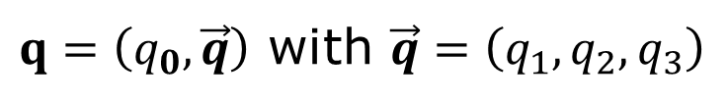
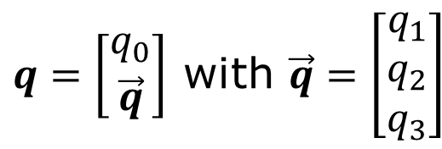
Alternative Quaternion Rotation Representation
Representing a Quaternion in Scalar + Vector form
$q=\left(q_{0},\vec{q}\right)$ with $\vec{q}=\left(q_{1},q_{2},q_{3}\right)$
or
$q=\left[\begin{matrix}q_{0} \\ \vec{q}\end{matrix}\right]$ with $\vec{q}=\left[\begin{matrix}q_{1} \\ q_{2} \\ q_{3}\end{matrix}\right]$
Then we can express the product of two quaternions as:
$$q⨂p=q_{0}p_{0}−q⋅p, q_{0}\vec{p}+p_{0}\vec{q}+\vec{q}×\vec{p}$$

Slide 33

What Does The Product of Rotational Quaternions Mean?
When p and q are rotational quaternions, their product
$$r=p⨂q$$
is also a rotational quaternion, corresponding to a new rotational vector, potentially in a new direction and with a new angle.

Slide 34

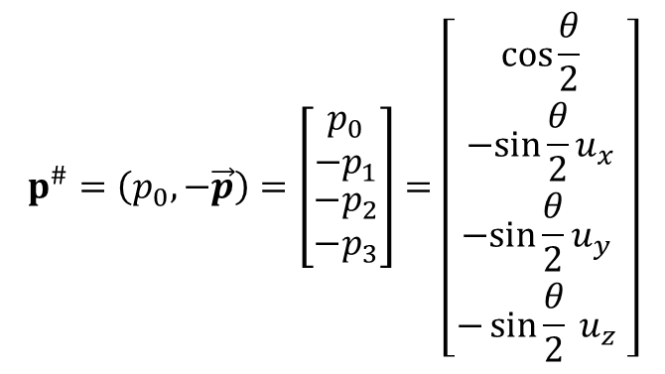
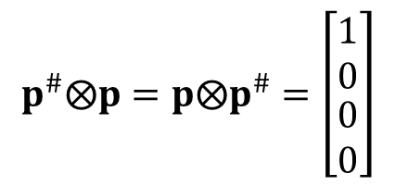
The Conjugate of a Quaternion
The conjugate of the quaternion
$p=\left(p_{0},\vec{p}\right)=\left[\begin{matrix}\begin{matrix}p_{o} \\ p_{1}\end{matrix} \\ \begin{matrix}p_{2} \\ p_{3}\end{matrix}\end{matrix}\right]=\left[\begin{matrix}\begin{matrix}\cos{\frac{θ}{2}} \\ \sin{\frac{θ}{2}u_{x}}\end{matrix} \\ \begin{matrix}\sin{\frac{θ}{2}u_{y}} \\ \sin{\frac{θ}{2}} u_{z}\end{matrix} \end{matrix}\right]$
$$p^{\#}=\left(p_{0},−\vec{p}\right)=\left[\begin{matrix}\begin{matrix}p_{0} \\ −p_{1}\end{matrix} \\ \begin{matrix}−p_{2} \\ −p_{3}\end{matrix}\end{matrix}\right]=\left[\begin{matrix}\begin{matrix}\cos{\frac{θ}{2}} \\ −sin{\frac{θ}{2}u_{x}}\end{matrix} \\ \begin{matrix}−sin{\frac{θ}{2}u_{y}} \\ −\sin{\frac{θ}{2}} u_{z}\end{matrix} \end{matrix}\right]$$
is defined as
$$p^{\#}⨂p=p⨂p^{\#}=\left[\begin{matrix}\begin{matrix}1 \\ 0\end{matrix} \\ \begin{matrix}0 \\ 0\end{matrix}\end{matrix}\right]$$
Note that, the conjugate has the property that

Slide 35
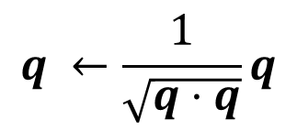

Advantage of Rotational Quaternion
Since a rotational Quaternion should have unit norm
$$q⋅q={q_{0}}^{2}+{q_{1}}^{2}+{q_{2}}^{2}+{q_{3}}^{2}=1$$
we can control computational errors by periodically normalizing the quaternion
$$q ←\frac{1}{\sqrt{q⋅q}}q$$

Slide 36
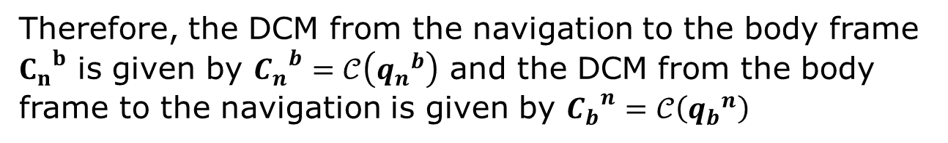
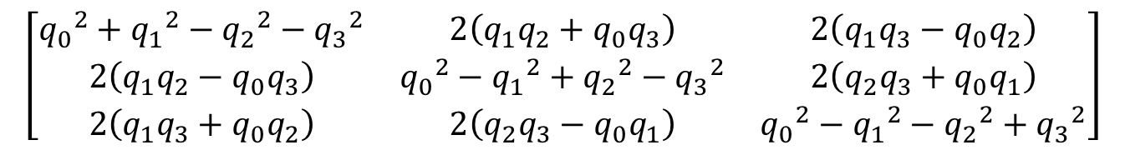

Relating a Quaternion To a Direction Cosine Matrix
If q represents the rotation from the one coordinate frame to another, the corresponding DCM is given by the formula
$$𝓒\left(q\right)=$$
$$\left[\begin{matrix}{q_{0}}^{2}+{q_{1}}^{2}−{q_{2}}^{2}−{q_{3}}^{2} & 2\left(q_{1}q_{2}+q_{0}q_{3}\right) & 2\left(q_{1}q_{3}−q_{0}q_{2}\right) \\ 2\left(q_{1}q_{2}−q_{0}q_{3}\right) & {q_{0}}^{2}−{q_{1}}^{2}+{q_{2}}^{2}−{q_{3}}^{2} & 2\left(q_{2}q_{3}+q_{0}q_{1}\right) \\ 2\left(q_{1}q_{3}+q_{0}q_{2}\right) & 2\left(q_{2}q_{3}−q_{0}q_{1}\right) & {q_{0}}^{2}−{q_{1}}^{2}−{q_{2}}^{2}+{q_{3}}^{2}\end{matrix}\right]$$
Therefore, the DCM from the navigation to the body frame ${C_{n}}^{b}$ is given by ${C_{n}}^{b}=𝒞\left({q_{n}}^{b}\right)$ and the DCM from the body frame to the navigation is given by ${C_{b}}^{n}=𝒞\left({q_{b}}^{n}\right)$

Slide 37
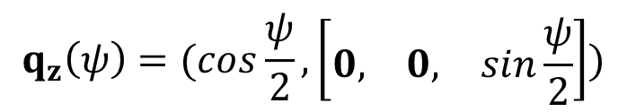
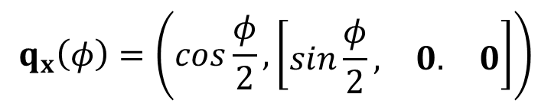
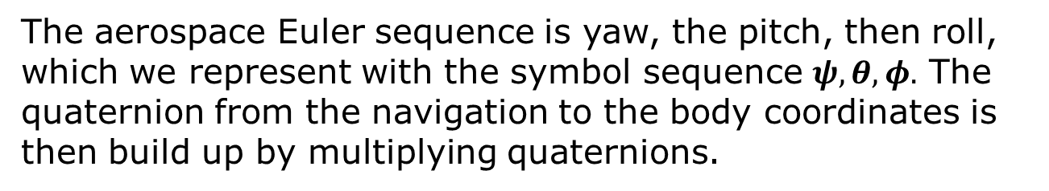

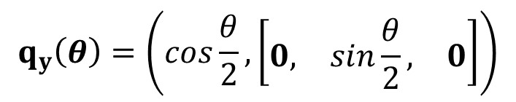
Aerospace Euler Angles to Quaternions (1)
The aerospace Euler sequence is yaw, the pitch, then roll, which we represent with the symbol sequence $ψ,θ,φ.$ The quaternion from the navigation to the body coordinates is then build up by multiplying quaternions.
$$q_{z}\left(ψ\right)=(cos\frac{ψ}{2},\left[\begin{matrix}0, & 0, & sin\frac{ψ}{2}\end{matrix}\right])$$
$$q_{y}\left(θ\right)=\left(cos\frac{θ}{2},\left[\begin{matrix}0, & sin\frac{θ}{2}, & 0\end{matrix}\right]\right)$$
$$q_{x}\left(φ\right)=\left(cos\frac{φ}{2},\left[\begin{matrix}sin\frac{φ}{2}, & 0. & 0\end{matrix}\right]\right)$$
Then
$${q_{n}}^{b}=q_{z}\left(ψ\right)⨂q_{y}\left(θ\right)⨂q_{x}\left(φ\right)$$

Slide 38

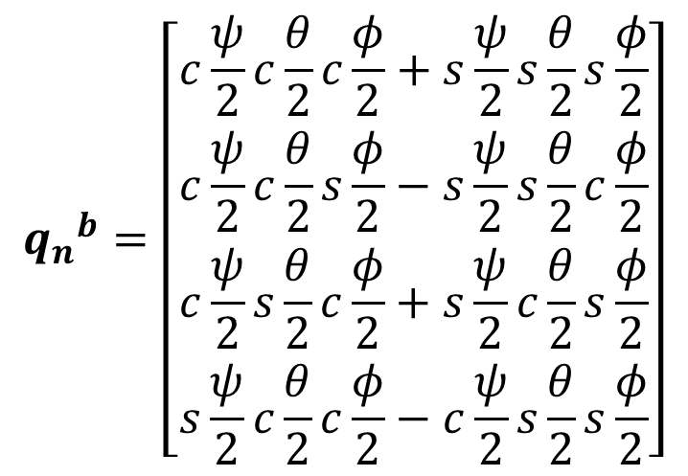
Aerospace Euler Angles to Quaternions (2)
The previous equation can be expanded to
$${q_{n}}^{b}=\left[\begin{matrix}\begin{matrix}c\frac{ψ}{2}c\frac{θ}{2}c\frac{φ}{2}+s\frac{ψ}{2}s\frac{θ}{2}s\frac{φ}{2} \\ c\frac{ψ}{2}c\frac{θ}{2}s\frac{φ}{2}−s\frac{ψ}{2}s\frac{θ}{2}c\frac{φ}{2}\end{matrix} \\ \begin{matrix}c\frac{ψ}{2}s\frac{θ}{2}c\frac{φ}{2}+s\frac{ψ}{2}c\frac{θ}{2}s\frac{φ}{2} \\ s\frac{ψ}{2}c\frac{θ}{2}c\frac{φ}{2}−c\frac{ψ}{2}s\frac{θ}{2}s\frac{φ}{2}\end{matrix}\end{matrix}\right]$$
$$and {q_{b}}^{n}={\left({q_{n}}^{b}\right)}^{\#}$$
Here “c” represents cosine and “s” represents sine.

Slide 39
Rates of Change of DCM and Quaternions with rotation

Slide 40
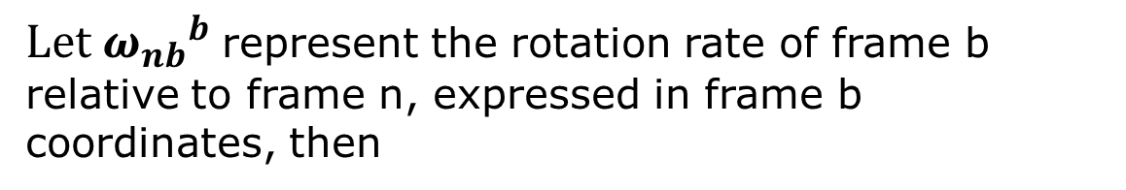
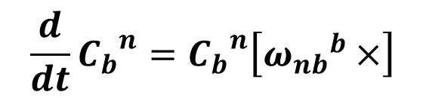
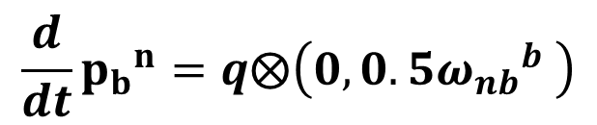
Differential Equation for Direction Cosine Matrix and Quaternion
$Let {ω_{nb}}^{b}$represent the rotation rate of frame b relative to frame n, expressed in frame b coordinates, then
$$\frac{d}{dt}{C_{b}}^{n}={C_{b}}^{n}\left[{ω_{nb}}^{b}×\right]$$
and with the quaternion q representing the transformation from frame b to frame n
$$\frac{d}{dt}{p_{b}}^{n}=q⨂\left(0,0.5{ω_{nb}}^{b} \right)$$

Slide 41
Implementation of Inertial Navigation Units (INU)

Slide 42
Tangent-Plane INU Navigation
-
+
+
+
C_{a}
Acc’s

Slide 43
Tangent-Plane INU Navigation
-
+
+
+
C_{a}
Acc’s
Gyros
C_{g}
+
-
-
+

Slide 44
Tangent-Plane INU Navigation
-
+
+
+
+
C_{a}
+
Acc’s
Gyros
C_{g}
+
-
-
+
IMU to Sensor Transformation

Slide 45
Tangent-Plane INU Navigation
-
+
+
+
+
C_{a}
+
Acc’s
Gyros
C_{g}
+
-
-
+
Note: Quantities in dashed circles can be reset by the information filter.
IMU to Sensor Transformation

Slide 46
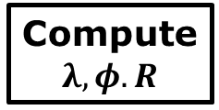

















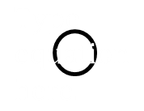















General Inertial Calculations
$$+$$
Acc
Compute
$$λ,φ.R$$
$$b_{a}$$
$$g^{n}$$
$$−$$
$$f^{n}$$
$$+$$
$$a^{n}$$
$$v^{n}$$
$${ω_{en}}^{n}$$
$$\frac{1}{s}$$
$$\frac{1}{R}$$
$${{\dot{C}}_{e}}^{n}=−\left[{ω_{en}}^{n}×\right]{C_{e}}^{n}$$
$$\frac{1}{s}$$
$$f^{b}$$
$$+$$
$$−$$
$${{C_{b}}^{n}f}^{b}$$
$$\left({ω_{en}}^{n}+2{ω_{ie}}^{n}\right)×v^{n}$$
$$+$$
Gyro
$${ω_{ie}}^{n}$$
$${C_{b}}^{n}$$
$$+$$
$${C_{e}}^{n}{ω_{ie}}^{n}$$
$$\frac{1}{s}$$
$$−$$
$$b_{g}$$
$$+$$
$${ω_{ie}}^{n}$$
$${ω_{ib}}^{b}$$
$${{\dot{C}}_{b}}^{n}={C_{b}}^{n}\left[{ω_{ib}}^{b}×\right]−\left[{ω_{in}}^{n}×\right]{C_{b}}^{n}$$
$$+$$
$${ω_{in}}^{n}$$

Slide 47
Self Leveling – Horizontal Alignment

Slide 48



Constant Velocity Alignment (1)
In theory, if the platform is stationary or moving a constant velocity, the accelerometers should be sensing only the force countering gravity, which gives the equation
$${C_{b}}^{n}{\hat{f}}^{b}=−g^{n}$$
Also, the rate gyros should be sensing only the earth’s rotation rate, which gives the equation
$${C_{b}}^{n}{{\hat{ω}}_{ie}}^{b}={ω_{ie}}^{n}$$
Furthermore, we want an orthogonal matrix, which leads to the equation
$${C_{b}}^{n}{\hat{f}}^{b}×{{\hat{ω}}_{ie}}^{b}=−g^{n}×{ω_{ie}}^{n}$$
In these equations, we have averaged to reduce the instrument noise.

Slide 49
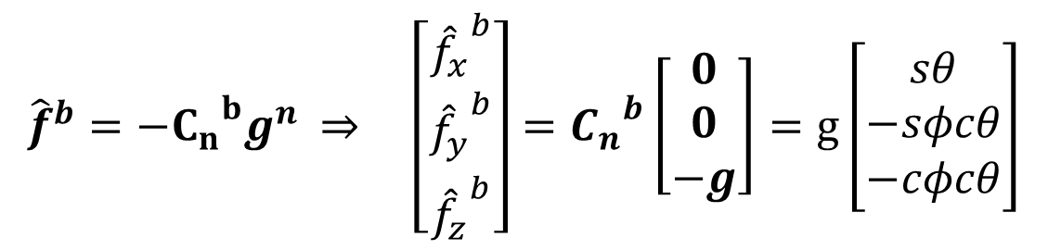


Constant Velocity Alignment (2)
Unfortunately, MEMS gyros have a turn-on-to-turn-on bias that is much larger than the earth rotation rate.
Therefore, for short alignment periods, we can only use the accelerometer equation.
We want the average specific force, as seen in the navigation (local level) frame ${\hat{f}}^{n}$ to equal $−g^{n}$, i.e.
$${C_{b}}^{n}{\hat{f}}^{b}={\hat{f}}^{n}={−g}^{n}$$
Or equivalently
$${\hat{f}}^{b}={−{C_{n}}^{b}g}^{n} ⇒ \left[\begin{matrix}{{\hat{f}}_{x}}^{b} \\ {{\hat{f}}_{y}}^{b} \\ {{\hat{f}}_{z}}^{b}\end{matrix}\right]={C_{n}}^{b}\left[\begin{matrix}0 \\ 0 \\ −g\end{matrix}\right]=g\left[\begin{matrix}sθ \\ −sφcθ \\ −cφcθ\end{matrix}\right]$$

Slide 50
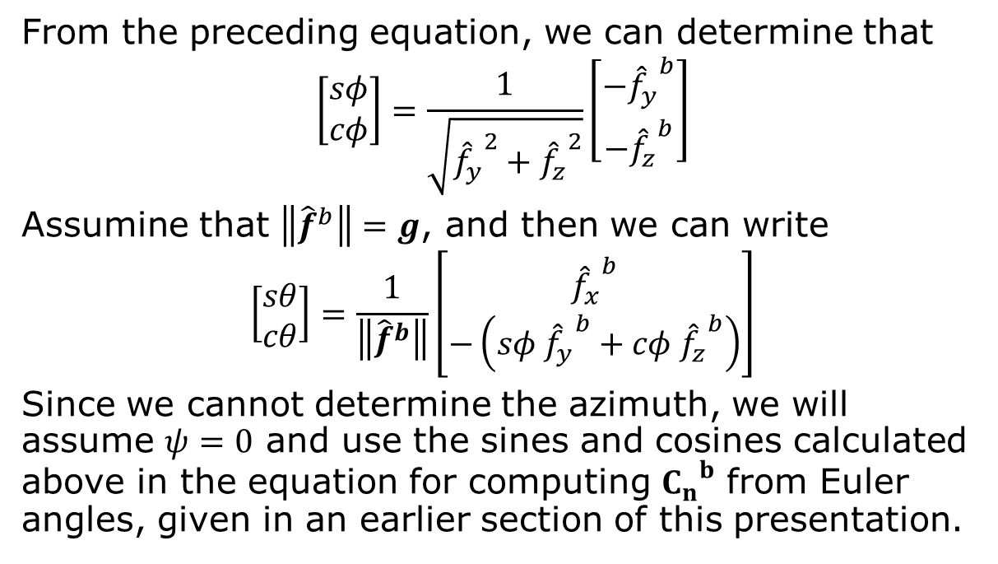
Constant Velocity Alignment (3)
From the preceding equation, we can determine that
$$\left[\begin{matrix}sφ \\ cφ\end{matrix}\right]=\frac{1}{\sqrt{{{\hat{f}}_{y}}^{2}+{{\hat{f}}_{z}}^{2}}}\left[\begin{matrix}−{{\hat{f}}_{y}}^{b} \\ −{{\hat{f}}_{z}}^{b}\end{matrix}\right]$$
Assumine that $\left\|{\hat{f}}^{b}\right\|=g$, and then we can write
$$\left[\begin{matrix}sθ \\ cθ\end{matrix}\right]=\frac{1}{\left\|{\hat{f}}^{b}\right\|}\left[\begin{matrix}{{\hat{f}}_{x}}^{b} \\ −\left(sφ {{\hat{f}}_{y}}^{b}+cφ {{\hat{f}}_{z}}^{b}\right)\end{matrix}\right]$$
Since we cannot determine the azimuth, we will assume $ψ=0$ and use the sines and cosines calculated above in the equation for computing ${C_{n}}^{b}$ from Euler angles, given in an earlier section of this presentation.

Slide 51






Constant Velocity Alignment (4)
We can also compute the quaternion ${q_{n}}^{b}$ that relates the navigation frame to the body frame. To use the formula given previously, we need the sines and cosines of the half angles, which we can get from the formulas:
$$c\frac{ψ}{2}=1, s\frac{ψ}{2}=0$$
$${q_{n}}^{b}=\left[\begin{matrix}\begin{matrix}c\frac{θ}{2}c\frac{φ}{2} \\ c\frac{θ}{2}s\frac{φ}{2}\end{matrix} \\ \begin{matrix}s\frac{θ}{2}c\frac{φ}{2} \\ −s\frac{θ}{2}s\frac{φ}{2}\end{matrix}\end{matrix}\right]$$
$$c\frac{θ}{2}=\sqrt{\frac{1+cθ}{2}}, s\frac{θ}{2}=\frac{sθ}{2c\frac{θ}{2}}$$
$$c\frac{φ}{2}=\sqrt{\frac{1+cφ}{2}}, s\frac{φ}{2}=\frac{sφ}{2c\frac{φ}{2}}$$
$${q_{b}}^{n}={\left({q_{n}}^{b}\right)}^{\#}$$

Slide 52
Limitations
The above procedure can only correct for platform pitch and roll.
Why can’t it correct for azimuth error?
What can we do to correct azimuth?
Magnetometer (outside)
Position Fix
GPS (outside)
WiFi (inside)
Landmarks (inside or outside)

